Slide 1
Schmitt Trigger using Dual output Second Generation Current Controlled Conveyor
Ajay Jagannath (18JE0049)
Akash Anand (18JE0054)
Venna Brahma Koti Reddy (18JE0913)
Under the Guidance of
Prof. Sajal Kr. Paul

Slide 2
Introduction
In this project, we implement a Current Controlled Conveyor based Schmitt trigger with high speed, low voltage, low power, high bandwidth and better hysteresis width compared to traditional Schmitt Triggers. The Schmitt trigger provides tuneability of the lower and upper threshold voltages, able to implement both clockwise and counter-clockwise hysteresis loops. We also study about one of its various applications- Switch Debouncing.
Flowchart of Steps
Construction of CCCII
Study of Port parameters
Schmitt Trigger using CCCII
Tuning of the Schmitt Trigger
Application of the Schmitt Trigger

Slide 3
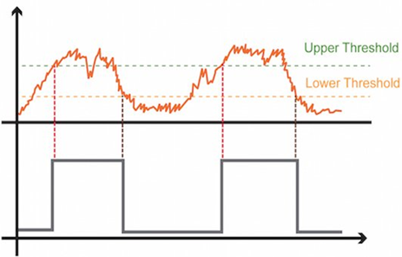
What is a Schmitt Trigger?
A Schmitt trigger is a comparator circuit with the positive feedback signal which ensures that the circuit has 2 different Threshold Voltages levels
Its Transfer Characteristics is a Hysteresis Loop
Useful in Noise Suppression and Pulse Shaping
Traditionally based on Op-Amp
Notes:
Having Two Threshold Voltages increases the Static Noise Margin of the Comparator.

Slide 4
Advantages of Current Mode Circuits
Higher Slew Rate
Lower Voltage/Power Consumption
Wider Bandwidth
Highly Linear
Notes:
Lower Power Consumption due to lesser parasitic components being involved.
Linear because generally feedback is not mandatory.

Slide 5
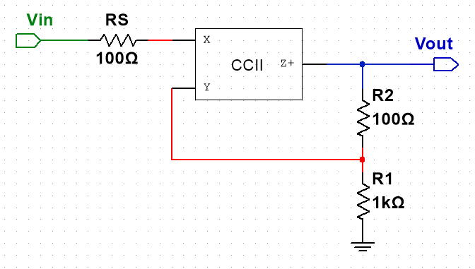
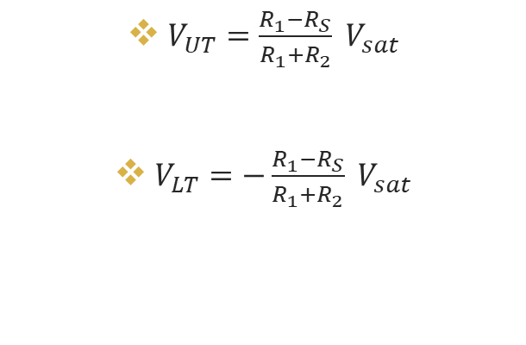
CCII+ Based Schmitt Trigger
$V_{UT}=\frac{R_{1}−R_{S}}{R_{1}+R_{2}} V_{sat}$
$V_{LT}=−\frac{R_{1}−R_{S}}{R_{1}+R_{2}} V_{sat}$

Slide 6
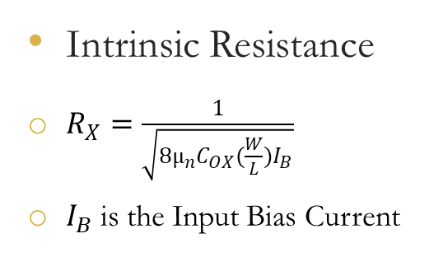
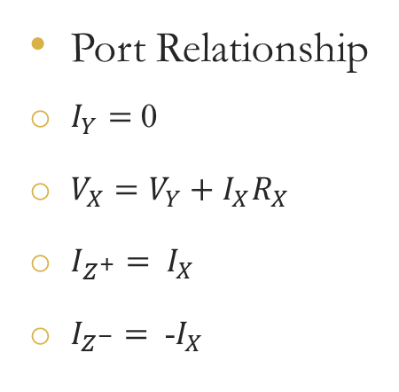
Current Controlled Conveyor (CCCII)
Port Relationship
$I_{Y}=$ 0
$V_{X}=V_{Y}+$ $I_{X}R_{X}$
$I_{Z^{+}}=$ $I_{X}$
$I_{Z^{−}}=$ -$I_{X}$
Intrinsic Resistance
$R_{X}=\frac{1}{\sqrt{8µ_{n}C_{OX}(\frac{W}{L})I_{B}}}$
$I_{B}$ is the Input Bias Current
Dual Output

Slide 7
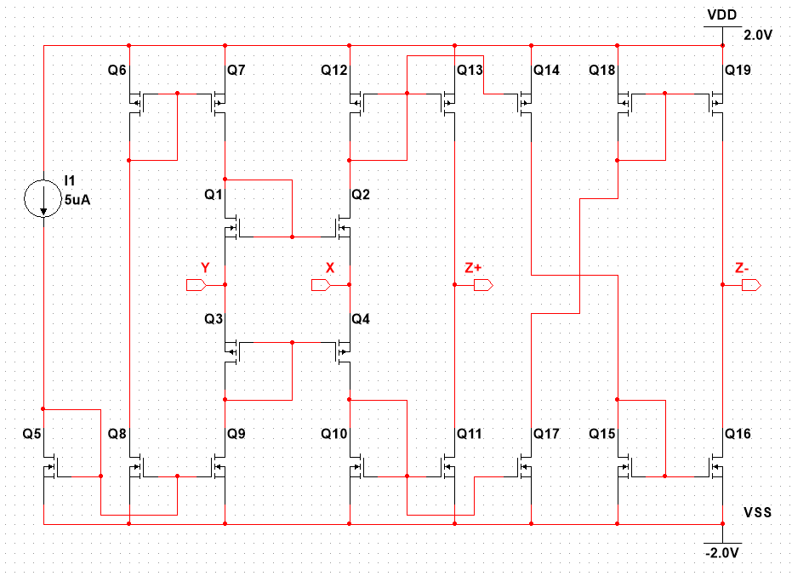
Internal Structure of CCCII

Slide 8
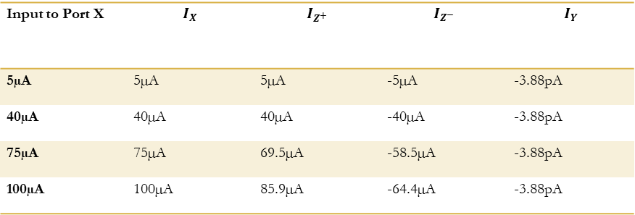
Studying the Port Relationship
Fixed Bias Current of 5µA
Port Y, Z+ and Z- Grounded
Varying DC current Given to Port X
Input to Port X | $$I_{X}$$ | $$I_{Z^{+}}$$ | $$I_{Z^{−}}$$ | $$I_{Y}$$
5µA | 5µA | 5µA | -5µA | -3.88pA
40µA | 40µA | 40µA | -40µA | -3.88pA
75µA | 75µA | 69.5µA | -58.5µA | -3.88pA
100µA | 100µA | 85.9µA | -64.4µA | -3.88pA

Slide 9
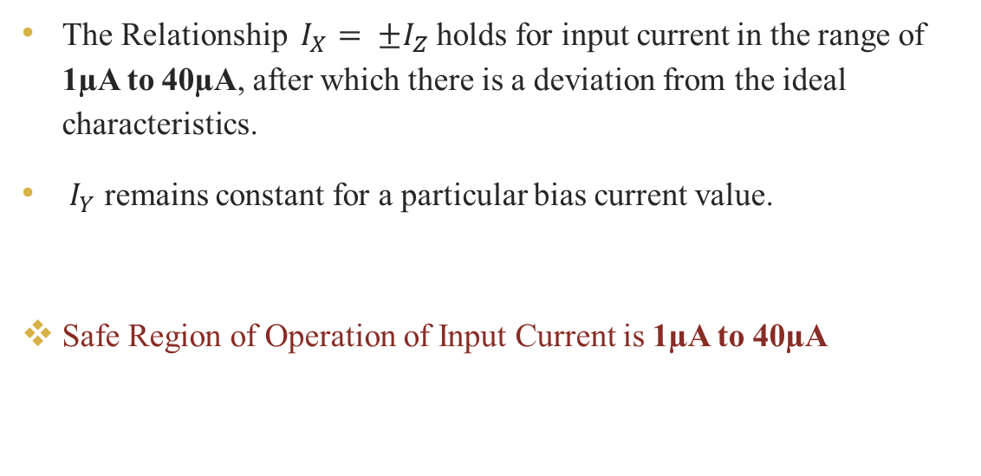
Studying the Port Relationship
The Relationship ${ I}_{X}$ ${= ±I}_{Z}$ holds for input current in the range of 1µA to 40µA, after which there is a deviation from the ideal characteristics.
${ I}_{Y}$ remains constant for a particular bias current value.
Safe Region of Operation of Input Current is 1µA to 40µA

Slide 10
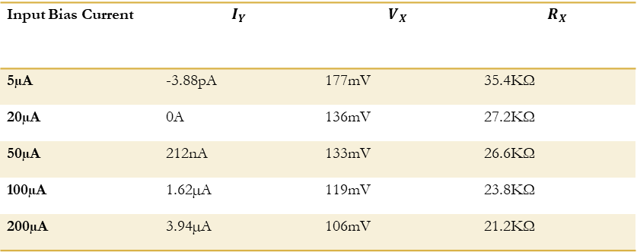
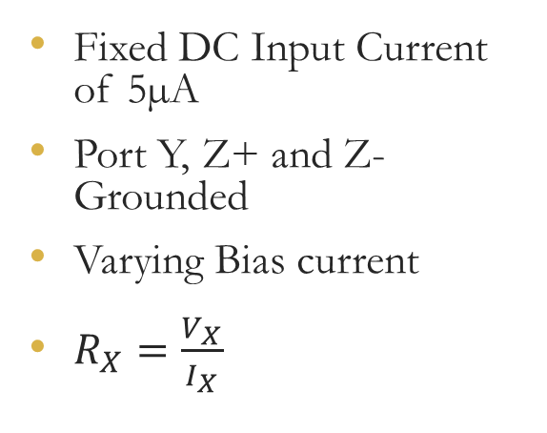
Studying the Port Relationship
Fixed DC Input Current of 5µA
Port Y, Z+ and Z- Grounded
Varying Bias current
$R_{X}=\frac{V_{X}}{I_{X}}$
Input Bias Current | $$I_{Y}$$ | $$V_{X}$$ | $$R_{X}$$
5µA | -3.88pA | 177mV | 35.4KΩ
20µA | 0A | 136mV | 27.2KΩ
50µA | 212nA | 133mV | 26.6KΩ
100µA | 1.62µA | 119mV | 23.8KΩ
200µA | 3.94µA | 106mV | 21.2KΩ

Slide 11
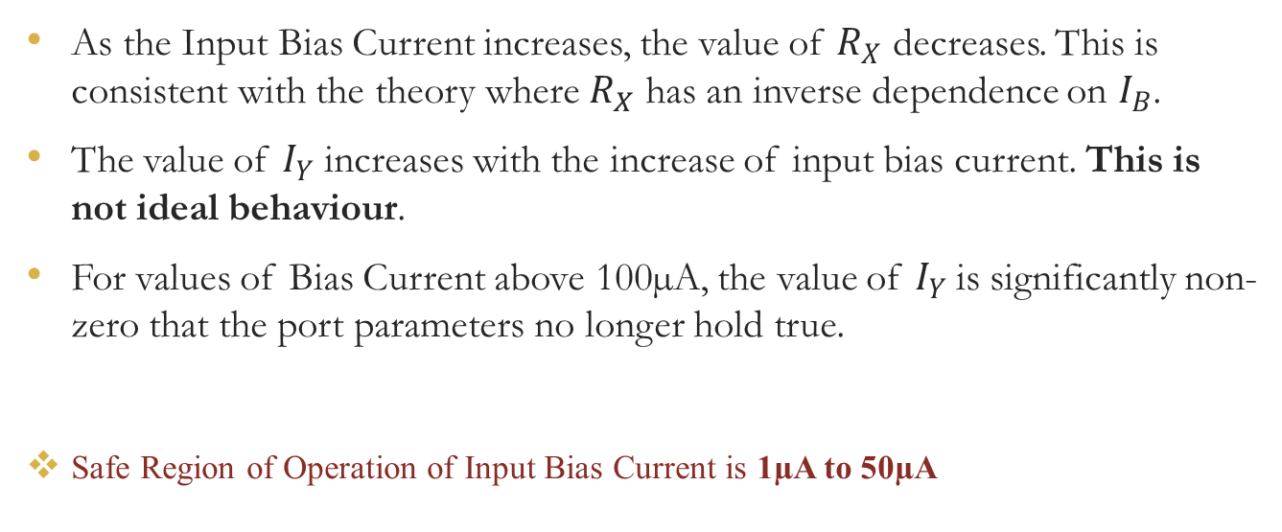
Studying the Port Relationship
As the Input Bias Current increases, the value of $R_{X}$ decreases. This is consistent with the theory where $R_{X}$ has an inverse dependence on $I_{B}$.
The value of $I_{Y}$ increases with the increase of input bias current. This is not ideal behaviour.
For values of Bias Current above 100µA, the value of $I_{Y}$is significantly non-zero that the port parameters no longer hold true.
Safe Region of Operation of Input Bias Current is 1µA to 50µA

Slide 12
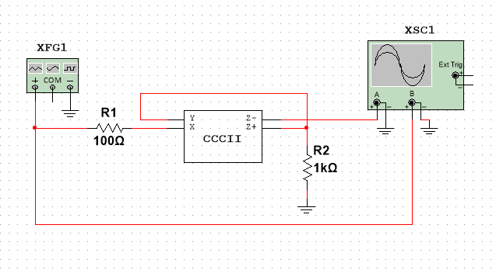
CCCII Based Schmitt Trigger
Non-inverting Schmitt Trigger with Clockwise Hysteresis made using CCCII with 2 passive components.
For Inverting Schmitt Trigger with Counter-Clockwise Hysteresis, just Switch the Z+ and Z- Ports.
Dual Output Schmitt Trigger using a Single CCCII Block
Notes:
Simulation Parameters
Supply Voltage: ±2V
Input Voltage: 0.5$V_{P}$, 2KHz Sinusoidal Wave.
Input Bias Current: 5µA
R1=100Ω
R2=1000Ω

Slide 13
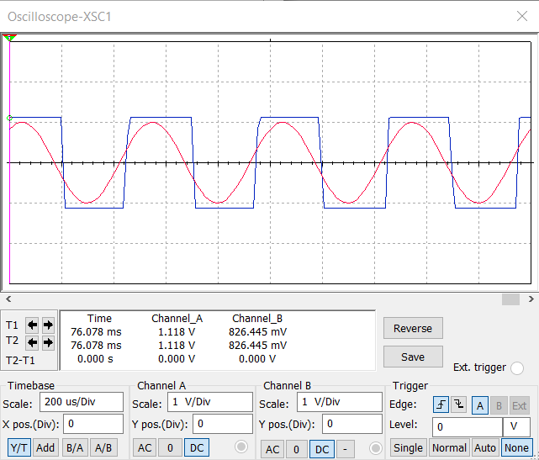
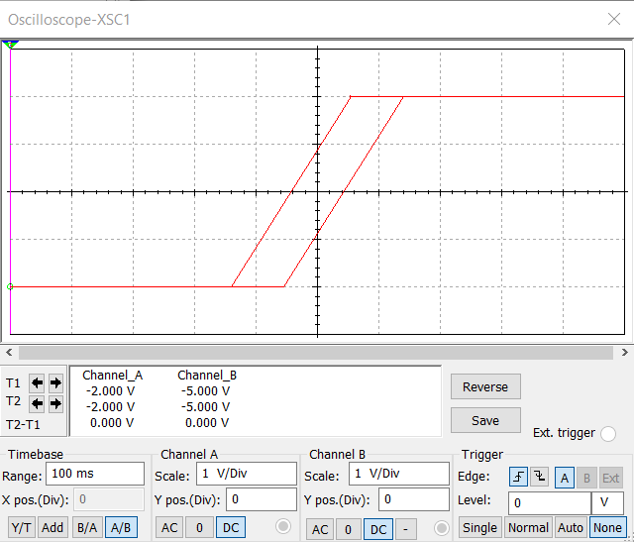
Non-Inverting Schmitt Trigger
Transient Analysis
Transfer Characteristics (CW Hysteresis)

Slide 14
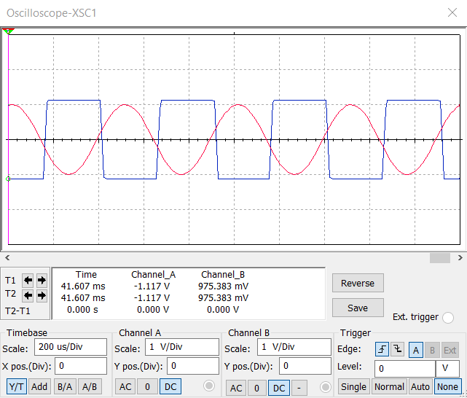
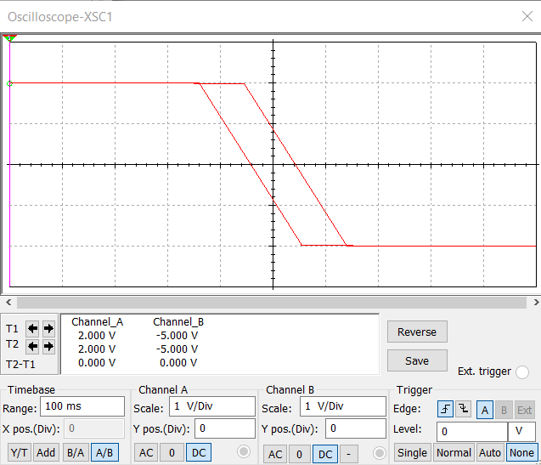
Inverting Schmitt Trigger
Transient Analysis
Transfer Characteristics (CCW Hysteresis)

Slide 15
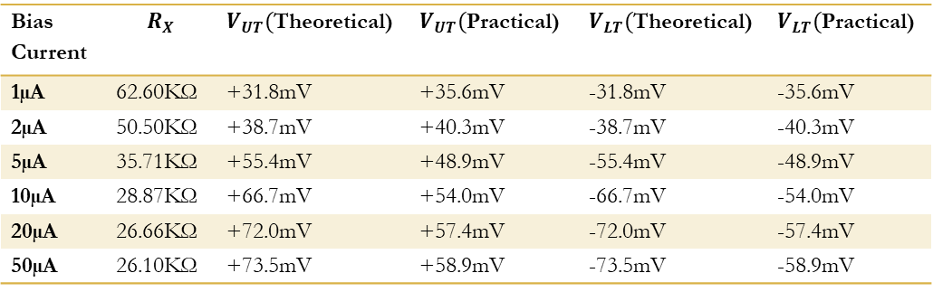
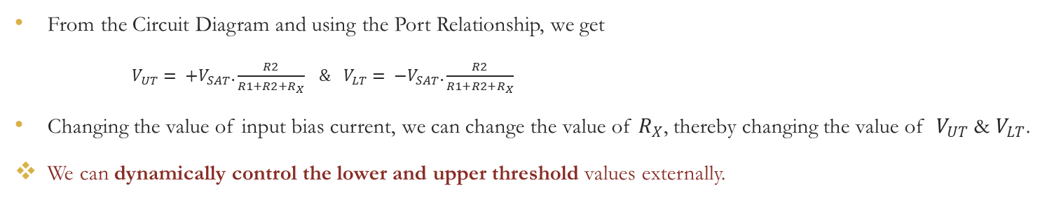
Tuning the Schmitt Trigger
From the Circuit Diagram and using the Port Relationship, we get
$V_{UT}= {+V}_{SAT}.\frac{R2}{R1+R2+R_{X}} \& V_{LT}= {−V}_{SAT}.\frac{R2}{R1+R2+R_{X}}$
Changing the value of input bias current, we can change the value of $R_{X}$, thereby changing the value of $V_{UT}$ & $V_{LT}$.
We can dynamically control the lower and upper threshold values externally.
Bias Current | $$R_{X}$$ | $V_{UT}($Theoretical) | $V_{UT}($Practical) | $V_{LT}($Theoretical) | $V_{LT}($Practical)
1µA | 62.60KΩ | +31.8mV | +35.6mV | -31.8mV | -35.6mV
2µA | 50.50KΩ | +38.7mV | +40.3mV | -38.7mV | -40.3mV
5µA | 35.71KΩ | +55.4mV | +48.9mV | -55.4mV | -48.9mV
10µA | 28.87KΩ | +66.7mV | +54.0mV | -66.7mV | -54.0mV
20µA | 26.66KΩ | +72.0mV | +57.4mV | -72.0mV | -57.4mV
50µA | 26.10KΩ | +73.5mV | +58.9mV | -73.5mV | -58.9mV

Slide 16
Improvements in CCCII Based Schmitt Trigger
Fewer resistances
While in use, Passive Components dissipate energy, leading to undesired power losses. Hence, minimizing their use will decrease power dissipation.
Control $V_{LT } \& V_{UT }$ values with external bias current
Control 𝑽_(𝑳𝑻 ) & 𝑽_(𝑼𝑻 ) values with external bias current
The threshold voltage values can be altered without changing the circuit parameters by changing the bias current $I_{B}$. Hence, The Schmitt Trigger can be said to be tuneable.
The threshold voltage values can be altered without changing the circuit parameters by changing the bias current 𝐼_𝐵. Hence, The Schmitt Trigger can be said to be tuneable.
Dual Output Circuit
Both inverting and non-inverting Schmitt trigger can be designed using a single CCCII block to provide both clockwise and counter-clockwise Hysteresis.

Slide 17
Application
Pulse Shaping
Convert a Sinusoidal/Triangular wave into a Square Wave of variable Duty Cycle.
Noise Suppression
Filter out Noise in the Circuit to High Static Noise Margin
Switching Activity
Acts like a Comparator Circuit
Switch Debouncing

Slide 18
Switch Bouncing
When a button of a switch is pressed, two metal contacts come into contact and the switch is toggled.
Practically, this process isn’t instantaneous. The metal contacts (connected to springs) move in and out of contact for a small time (called transient period) before settling into the final state.
This is analogous to a ball being dropped from a height onto the ground.
While, this transient time is very quickly for human perception, one single switching causes multiple triggering, damaging the circuit in the long run and also causes errors in logical circuits like counters.

Slide 19
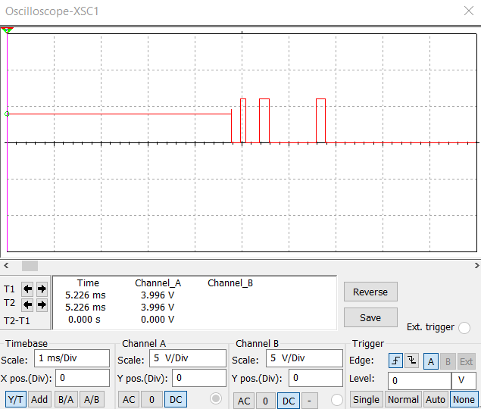
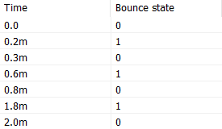
Switch Bouncing
Switch Bouncing is an Hardware Phenomenon
Using a Voltage Controlled SPST Bounce switch with Configurable Bounce Pattern Triggering at 5V and,
Using a Step Voltage moving from 4V to 6V after 10ms, we get the Switch bouncing Waveform

Slide 20
Switch Debouncing
Stage A
Passing the Bouncing Signal Through a RC Filter Circuit which removes the multiple fluctuations from high to low within the Transient Time with the help of charging/discharging of the capacitor.
Stage B
Pass Output Signal from Stage A through a Schmitt Trigger which suppresses noise to give a debounced signal which performs Switching from high to low at the desired time.

Slide 21
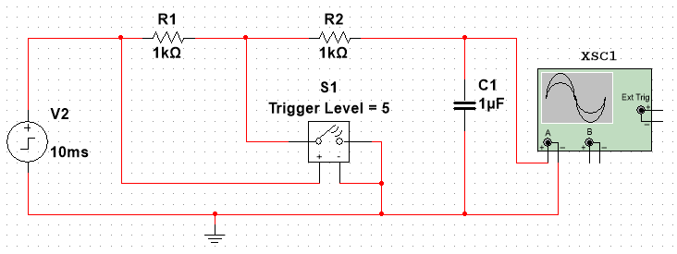
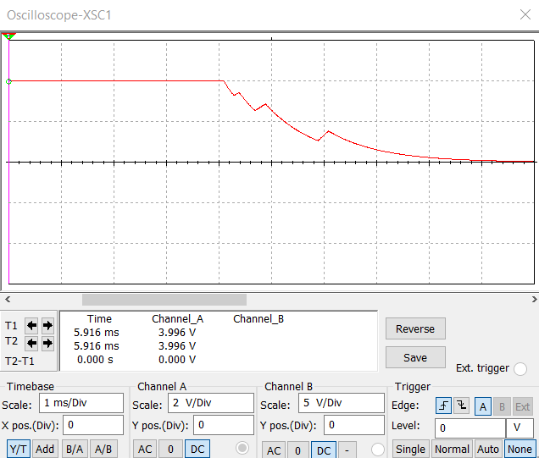
Stage A - RC Filtering
Circuit Diagram
Output Waveform

Slide 22
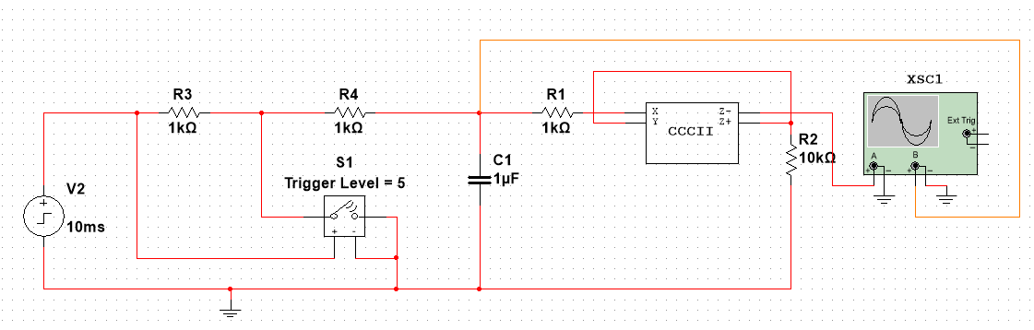
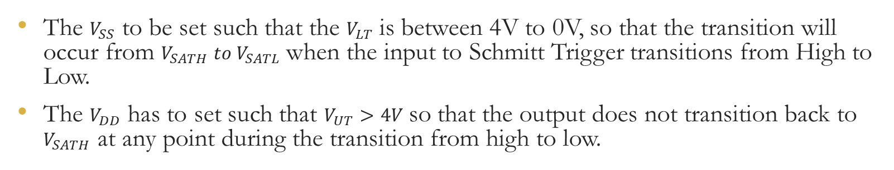
Stage B - Using the Schmitt Trigger
The $V_{SS}$ to be set such that the $V_{LT}$ is between 4V to 0V, so that the transition will occur from $V_{SATH} to V_{SATL}$ when the input to Schmitt Trigger transitions from High to Low.
The $V_{DD}$ has to set such that $V_{UT}>4V$ so that the output does not transition back to $V_{SATH}$ at any point during the transition from high to low.

Slide 23
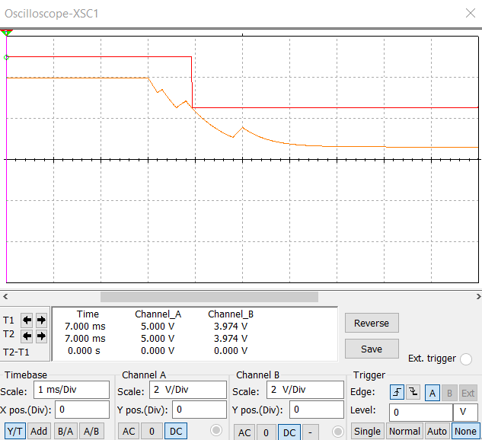
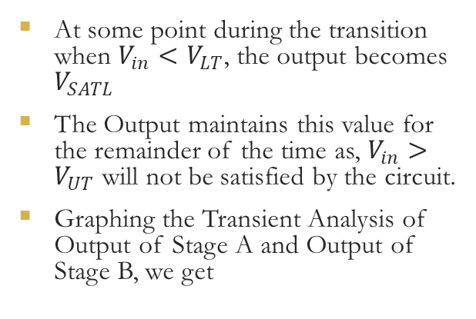
Debounced Signal
At some point during the transition when $V_{in}<V_{LT}$, the output becomes $V_{SATL}$
The Output maintains this value for the remainder of the time as, $V_{in}>V_{UT}$ will not be satisfied by the circuit.
Graphing the Transient Analysis of Output of Stage A and Output of Stage B, we get

Slide 24
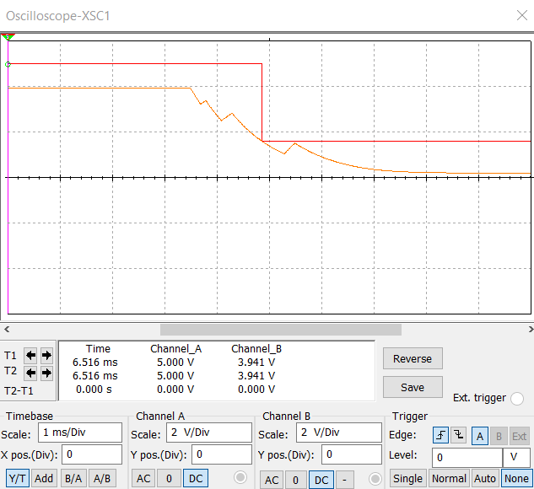
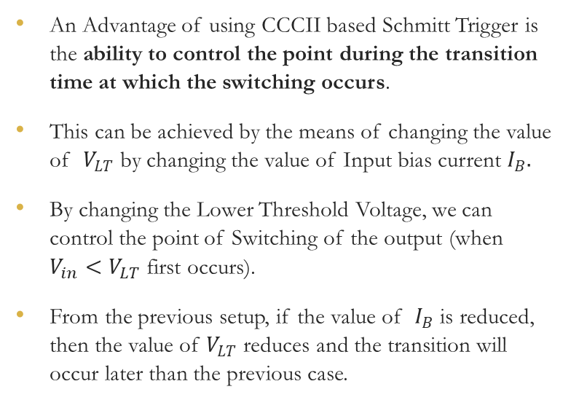
Switching Time
An Advantage of using CCCII based Schmitt Trigger is the ability to control the point during the transition time at which the switching occurs.
This can be achieved by the means of changing the value of $V_{LT}$ by changing the value of Input bias current $I_{B}.$
By changing the Lower Threshold Voltage, we can control the point of Switching of the output (when $V_{in}<V_{LT}$ first occurs).
From the previous setup, if the value of $I_{B}$ is reduced, then the value of $V_{LT}$ reduces and the transition will occur later than the previous case.

Slide 25
Conclusion
This work presents the construction of a Schmitt Trigger using CCCII and its advantages over traditional Voltage mode Schmitt Triggers and Simple CCII Schmitt Trigger.
CCCII was constructed using CMOS Transistors and its Port Parameters were studied and the safe region of operation was determined.
Using this CCCII, Schmitt Trigger was constructed and the transient analysis and Hysteresis characteristics were observed for both the Clockwise (non-inverting) and Counter-Clockwise (inverting) Loop and the value of lower and upper threshold voltages were found to be tunable by varying the value of the input bias current.
Switch Debouncing of a software simulated Bounced Signal was performed using the said CCCII based Schmitt Trigger with the help of a RC Filter Circuit.

Slide 26
Future Scope
Using no passive components in the construction the Schmitt Trigger, thereby drastically reducing the power dissipation when the circuit is in operation. This will also make fabrication of ICs simpler and faster.
Reducing the Supply Voltage of the CMOS Circuit to reduce power consumption of the circuit while in operation.
Synthesis the circuit using Software such as Cadence Virtuoso and Implementing a CMOS technology <= 180nm.

Slide 27
Thank you

